Slide 1
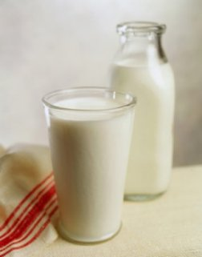
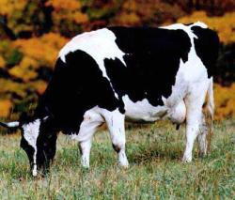
Role of the milk-born negative regulatory system in control of milk secretion, milk composition and induction of mammary gland involution
Nissim Silanikove, ARO, Israel (on sabbatical leave in UC , USA)

Slide 2
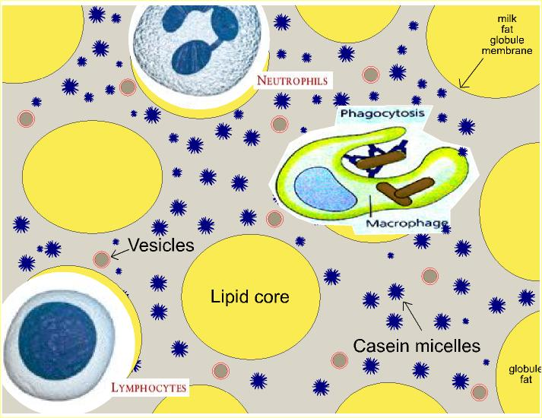
Milk phases

Slide 3
Role of Milk in the Regulation of Milk Secretion:
Negative Feed Back Mechanism Induced By Milk Components

Slide 4
Occasional changes in gland emptying

Slide 5
Daily changes in breast volume

Slide 6
Daily changes in breast milk synthesis

Slide 7
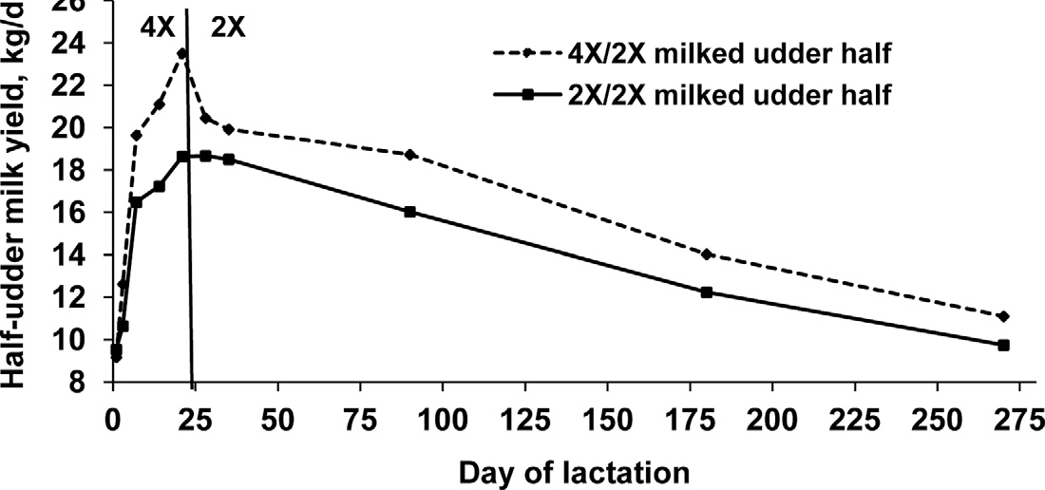
Effect of milk frequency on the glandular level on MY in cows
Wall and McFadden, JDS 2008

Slide 8
Feedback Mechanism – The FIL Concept
Rate of Milk Removal

Slide 9
Does mammary gland fill (pressure) has negative feedback regulatory role?
Points for consideration:
. No convinced evidence presented so far
. Peaker and Henderson show that inflating the mammary gland of goats with air did not affect milk secretion (J Physiol, 80th)
. Species differences in anatomy of the gland should be considered

Slide 10
Mammary gland gross anatomy

Slide 11
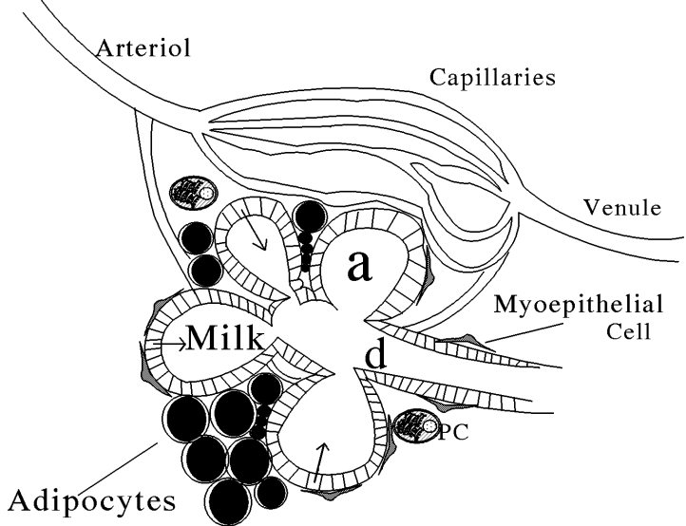

Slide 12
Mammary gland serotonin system
The mammary gland serotonin system has been proved to play important autocrine-paracrine role in the regulation of milk secretion
However, this system does not appear to be a component of the milk-born negative regulatory system:
Intammammary treatment of the glands affected also non-treated gland; i.e., it has systemic effect (Collier et al., JDS)
mammary gland derived serotonin affect parathyroid related hormone and Ca mobilization from bones; i.e., it has systemic-endocrine effect (horsemann et al., AJP)

Slide 13
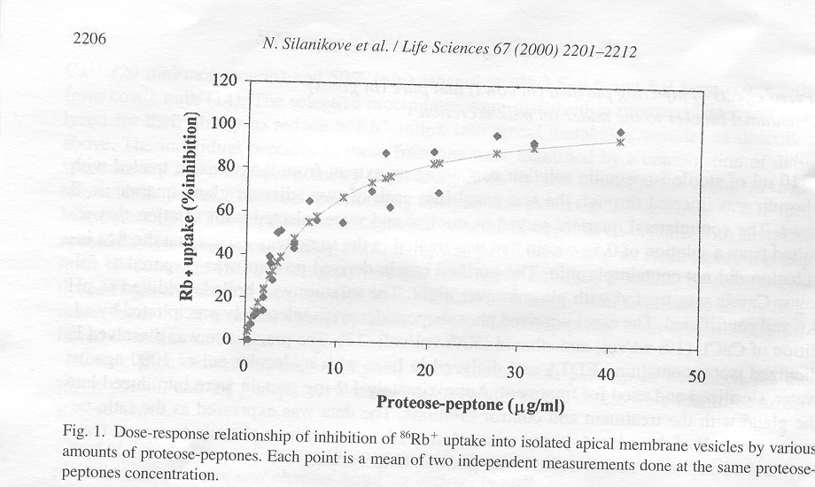
Dose-response

Slide 14
The K⁺ blocking activity relates to casein-derived (proteose-peptone) phosphopeptide
1. Precipitated by acetone
2. Specifically precipitated by Ca²+ (1% wt/vol) and ethanol at pH 3.5- an indication that the factor is multi- phosphorilated.
3. Strong proteolytic enzymes such as pronase and proteinase K eradicated its activity.
4. Boiling resistance.

Slide 15
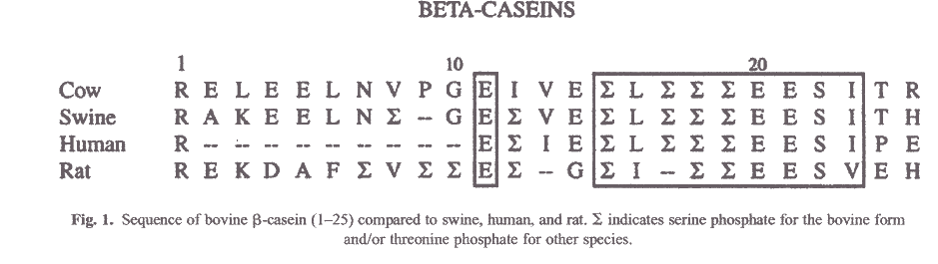
B-CN 1-25 sequence

Slide 16
Plasminogen/Plasmin System

Slide 17
Milk plasminogen and plasmin concentrations (throughout lactation)

Slide 18
Milk plasmin x Milk yield x bST (throughout lactation)

Slide 19
Stress and the plasmin system
The effect of dexamethasone on the PPS system in cows
Treatment | Control
*17.3±0.2 | 11.8±0.1 | PA (units/ml)
*8.75±0.8 | 5.42±0.9 | Plasmin (units/ml)
24.8±2.1 | 27.3±1.4 | Plasminogen (units/ml)
*2.83±0.9 | 5.03±0.8 | Plasminogen/Plasmin
Values are mean ± SE; *P < 0.05 by t-test
Silanikove et al, Life Sci., 2000

Slide 20
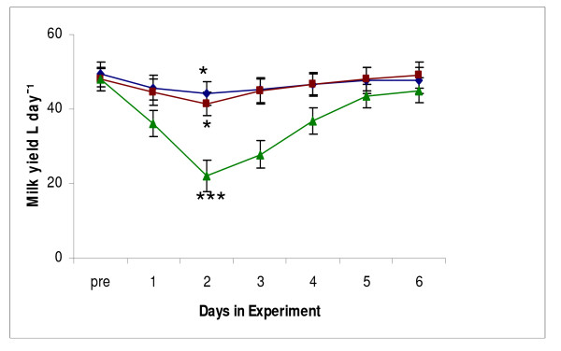
Effect of treatments on milk yield and its post-treatment recovery. (diamonds, treatment C; squares, treatment D; triangles, treatment E; * P < 0.05 in comparison with pretreatment values; *** P < 0.001 in comparison with pretreatment values and treatments C and D).
Silanikove et al. BMC Physiology 2009 9:13

Slide 21
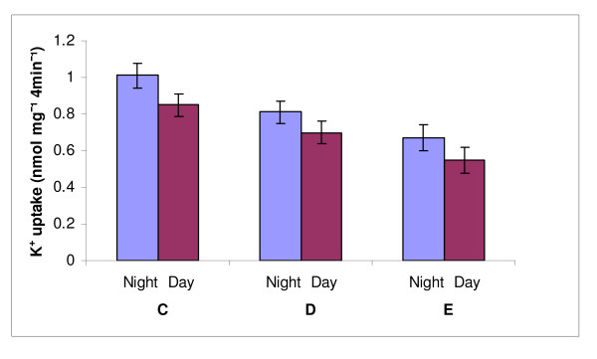
Effect of treatments and time of sampling on K⁺ uptake into vesicles derived from milk serum and incubated with the respective infranatant (milk serum devoid of vesicles and casein micelles). All the treatments (C, Control, D, treatment D, E, treatment E) and sampling time within treatment (night vs. day) effects were significant at P < 0.05).
Silanikove et al. BMC Physiology 2009 9:13

Slide 22
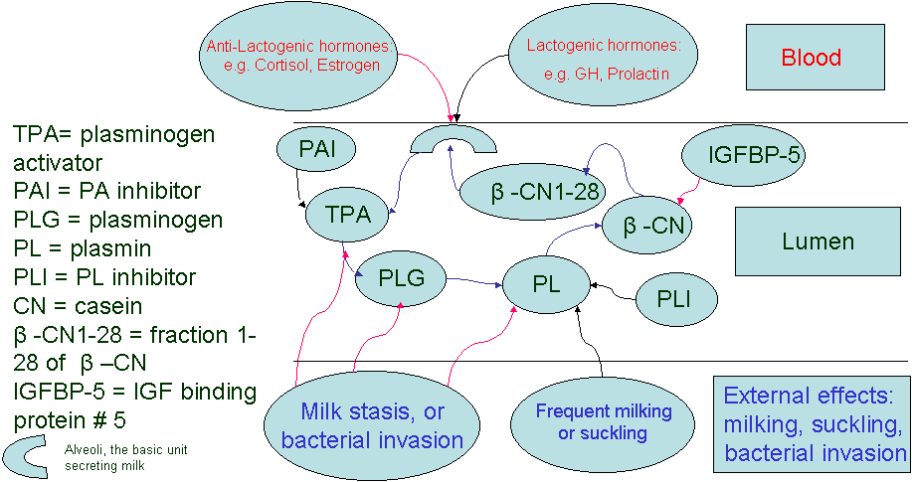
The Negative Feedback Mechanism Flow-Chart: The ARO View.
Blue arrows denote flow of signal along the feedback loop, red arrows denote positive effect and black arrows denote suppressive effect

Slide 23
Animal model built on the gland level
One udder-half identified with CNS
species and the contra-lateral being
free of bacteria
S. caprae
S. chromogenes
S. epidermidis
S. simulans
S. xylosus
+
-

Slide 24
Milk yield (half) of sheep or goat infected with CNS specie in one gland and the contra-lateral being free.
Sheep – open bars
Goats – hatched bars
Leitner et al., JDS, 2004

Slide 25
Plasmin activity: sheep or goat with one gland infected with CNS specie and the
contra-lateral being free
Sheep + 73.7%, P < 0.0007
Goat + 195%, P < 0.0003
PL activity, units/mL
Leitner et al, JDS, 2004

Slide 26
Proteose-peptone concentration: sheep or goat with one gland infected with CNS specie and the contra-lateral being free
Sheep + 247%, P < 0.0001
Goat +151%, P < 0.0001
P-p, g/L
Leitner et al, JDS, 2004

Slide 27
Conclusions
The basal level of PL activity is higher in sheep than in goats, which explains the higher basal level of proteose-peptone
PL activity in infected glands is higher in sheep than in goats, which explains the higher increase in proteose-peptone
The higher increase in proteose-peptone concentration in sheep than in goats explains the more acute reduction in milk yield in sheep

Slide 28
Role of the plasmin (milk-born) system in regulation of milk composition
Plasmin activity is the main contributor for degradation of casein during clinical and sub-clinical mastitis and late lactation- is there is physiological reason for that?
The above situation are characterized by reduction in milk lactose concentration – is there is a physiological reason; what's the connection to casein degradation?

Slide 29
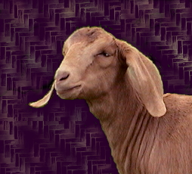
Milk yield and SCC along the
lactation of uninfected glands
1000
3.5
Milk K/day
SCC (1000)
0.5
100
Day in milk

Slide 30
Log SCC and Cf of curd of goat milk at mid lactation with and without IMI and at the end of lactation without IMI
Low quality curd
Log SCC
correlation ( r= -0.4(
Curd firmness (Cf)

Slide 31
% lactose and Cf of curd of goat milk at mid lactation with and without IMI and at the end of lactation without IMI
Low quality curd
% Lactose
Lactose lower than
4%
Curd firmness (Cf)

Slide 32
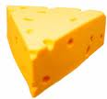
Mean and SE of sheep milk and constituents
according to time in the lactation and IMI
Curd firmness (V)
Clotting time (sec)
ML-F = mid lactation free; ML-I = mid lactation infected; EL = end lactation

Slide 33
Influence of percent lactose in milk on curd
firmness as measured by the Optigraph

Slide 34
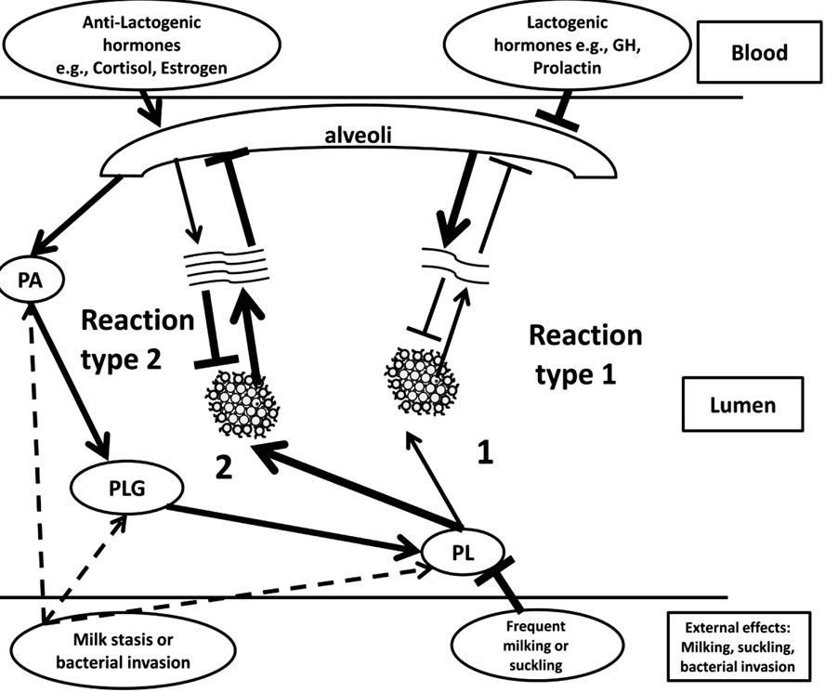

Slide 35
Role of the Plasmin System in Induction of Active Involution

Slide 36
What happens in case of surplus?

Slide 37
Involution

Slide 38
Involution
Definition

Slide 39
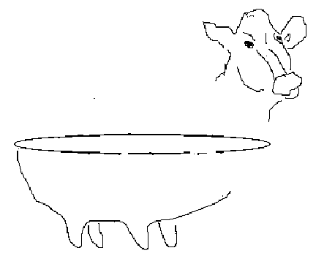
The model:
Each goat or cow were Injected
with casein hydrolyzate in the experimental
gland (+) whereas the control gland (-) was
treated with intact casein
+
-

Slide 41
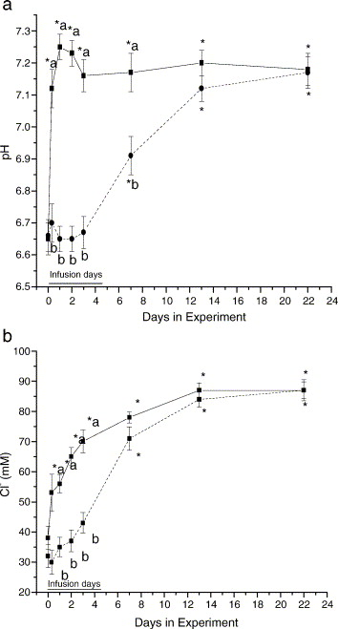

Slide 42
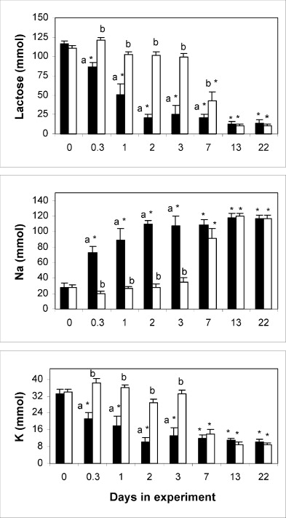

Slide 43
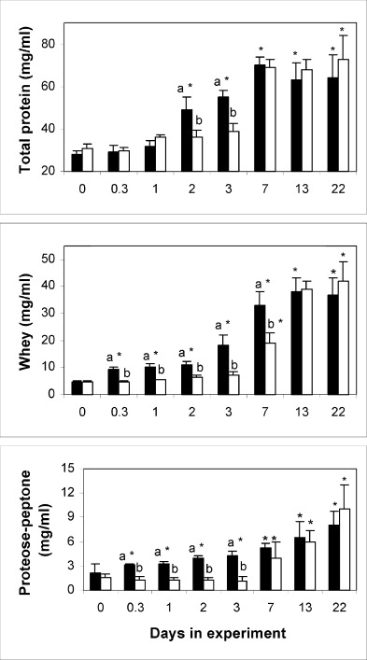

Slide 44
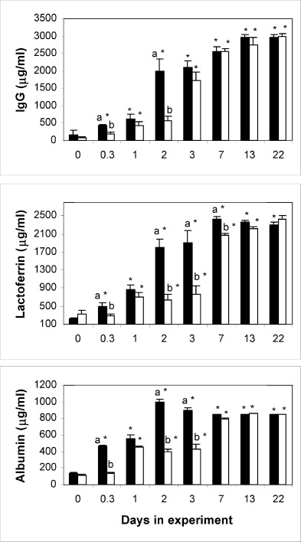

Slide 45
Treatment
Control
5000
)
4000
1000
x
3000
(
SCC
2000
1000
0
0
12
48
144
Time After Treatment (h)

Slide 46
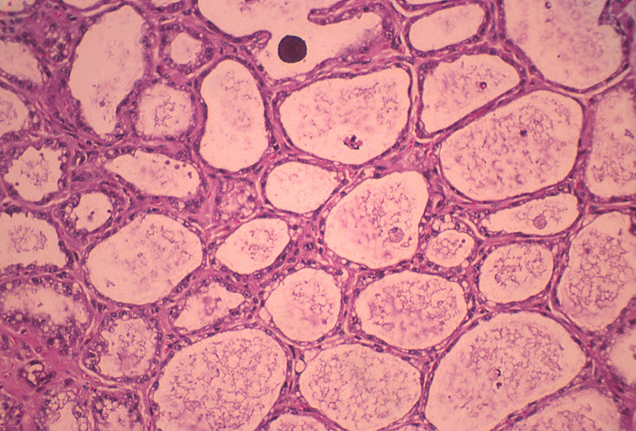
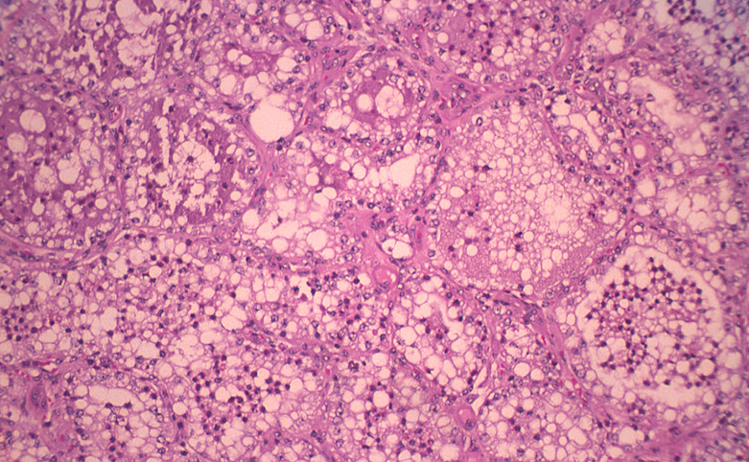

Slide 47
Dry Cow Therapy, Mastitis and Milk - Enhancement
Nissim Silanikove, Agricultural Research Organization, Institute of Animal Science, Israel.

Slide 48
Mastitis
Mastitis affects one third of all dairy cows annually ¹
Conventional
Organic
U. K.
37.1
34.7
¹ National Mastitis Council, Current Concepts in Bovine Mastitis, Madison, WI, 1996.

Slide 49
Mastitis Costs
$
Mastitis costs the U.S. dairy industry over $2 Billion annually (W L Hurley, Department of Animal Sciences, University of Illinois, 2001.)
The worldwide estimated cost of mastitis to the dairy industry is $10.34 Billion annually.

Slide 52
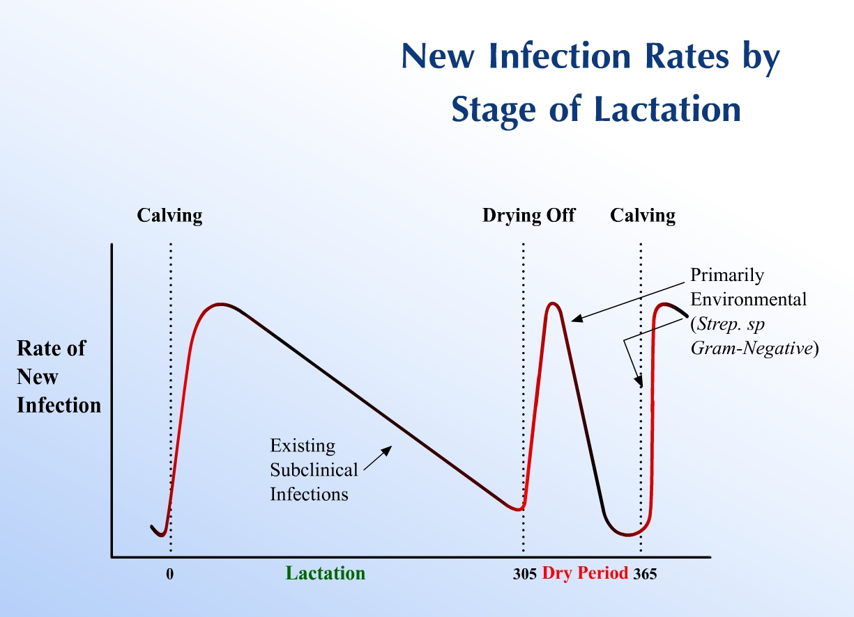

Slide 53
Bacterial status (infected, noninfected, chronic, clinic and cured) in period 2 (following Nafpenzal DC+ CNH at DCT) and period 3 (following Nafpenzal DC)
P [χ²] | Period 3 | Period 2
 | 83/332 | 92/368 | Cow/glands | Before drying off
 | 274/332 (82.5) | 326/368 (88.6) | Uninfected
 | 58/332 (17.5) | 42/368 (11.4) | Infected
NS | 259/274 (94.5) | 312/326 (95.7) | Uninfected¹ | Postpartum
 | 15/274 (5.5) | 14/326 (4.3) | Chronic²
 | 20/274 (7.3) | 28/326 (8.6 | clinic³
0.025 | 30/58 (51.7) | 31/42 (73.8) | Cured⁴
 | 28/58 (48.3) | 11/42 (26.2) | Not Cured ⁵
¹ Uninfected quarter before drying off and uninfected at parturition.
² New Infection, chronic – Infection was detected during parturition and in the first 100 days in the new lactation: The same udders were uninfected before drying off.
³ New Infection, clinical – Infection was detected during the first month after parturition and remained for the first 100 days in the new lactation: The same udders were uninfected before drying off.
⁴Cure – Bacteria detected in the month preceding dry off was not detected in the same udder during the first 100 days of lactation
⁵ Not Cured – The reciprocal of cured: Bacteria detected in given udders in the month preceding dry off was also detected in the same udder during the first 100 days of the subsequent lactation.

Slide 55

Cow 2425

Slide 56
Conclusions
CNH improve dramatically milk hygiene immediately, without the need to discard milk from the uninfected gland.
CNH is effective where no alternative treatments exist.
CNH gained high rate of bacterial cure, with secretion of milk with low SCC during the next lactation cycle.
CNH is effective as a dry period treatment: eradicates existing infections, prevents new infections and lowers SCC.
CNH increases milk yield similar to growth hormone.
CNH has the potential to shortens the length of the dry period without adversely affecting milk yield in the subsequent lactation.
.

Slide 57
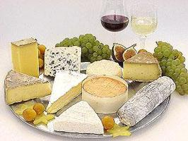
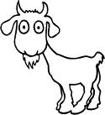


Thanks

